Slide 1
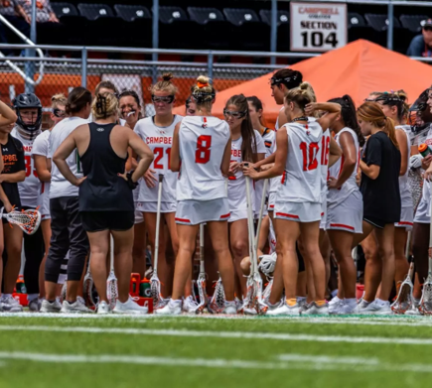
Physical & psychological factors affecting the female collegiate lacrosse athlete & performance
Paula Parker, EdD, CMPC®
Department of Exercise Science
Abby Cooley, MSPH Candidate
Campbell University School of Osteopathic Medicine, Class of 2028
Behavioral Health & Wellness Manager: Campbell Community Care Clinic
Notes:
Understanding contributing factors for sport and human performance is a growing research field as microtechnology has advanced and
become more affordable. However, the primary focus of the sport science literature has been centered on elite/professional male
athletes, with only a small portion of the literature devoted to collegiate athletes and even less devoted to female athletes. Collegiate
athletes are unique compared to their professional counterparts due to the academic demands of the student-athlete. Further, female athletes
are different from their male counterparts physiologically and psychologically. The purpose of this symposium is to discuss the
influencing factors for sport performance in Division I female athletes. Data presented will include performance information obtained from
microtechnology (e.g., global positioning systems, accelerometers, heart rate monitors), game statistics, daily wellness assessments,
sleep assessments, psychological hardiness measures, and ratings of perceived exertion. The presenters will discuss the relationships between these data and how female student-athletes’ performance and wellness fluctuate with the training year and the academic calendar. Information presented will focus on four years of data collection with a collegiate women’s lacrosse team and will be compared to research findings research findings from other collegiate
female athletes as well as counterpart populations (e.g., male lacrosse players, male collegiate athletes). Identifying unique physiological and
psychological factors in female collegiate athletes can lead to recommendations for application. These recommendations will include how researchers, sport coaches, strength and conditioning coaches, sports medicine and sport psychologists may manage training to see better physical and mental outcomes in their athletes.

Slide 2
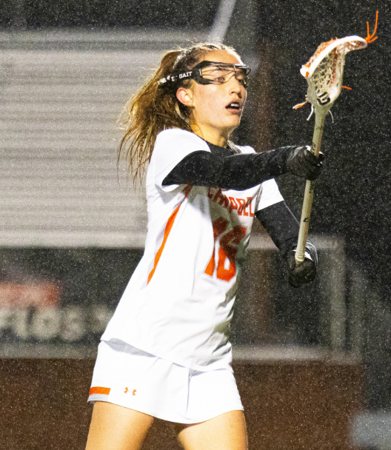
Purpose
To discuss the influencing factors for sport performance in Division I female athletes
Objective data
Subjective data
Notes:
Jen
Coaches want help but may not be asking
No manipulation of how the team does things

Slide 3
Why this population?
Small portion of the literature devoted to collegiate athletes & even less devoted to female athletes.
Collegiate athletes are unique due to the academic demands of the student-athlete.
Female athletes are different from their male counterparts physiologically and psychologically.
Longitudinal assessment of 7 years and counting
Notes:
Jen

Slide 4

THANK YOU!
Dr. Jennifer Bunn
  Sam Houston State University
Olivia Sisson
Brynn Hudgins
Kattie Alphin
Dalton Garner
Camden Johnston
Justin Clark
Megan Frick
Matt Hamlet
Jenna Carter
Libby Bynum
Charli Rosenberg
Andrew Thornton
Brianna Robinson
Austin Calhoun
Monseratt Andrade
Abby Cooley
Sarah Grace
Allison Peele
Alyson Kidd
Emma Carew
Elaine Smith
Shania Roehrich
Jordan Riggs
Lio Sevelio
Diana Guerrero-Neito
Arianna Hunsucker
Sara Honeycutt
Ella Coleman
Levi Chamberlain
Taylor Gery
Cecilia Pasquarella
Carson Pina

Slide 5
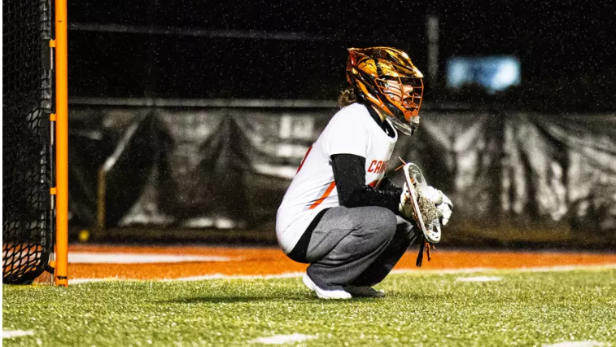
Research funding in part by:
Campbell Women’s Lacrosse
National Association for Kinesiology in Higher Education (NAKHE) Hellison Interdisciplinary Research Grant
Ester H. Howard Student Research Fellow Grant

Slide 6
Athlete Monitoring
Better training
Reduce injury risk
Return to play
Manage workload
Work from the field
Objective data
Subjective data
Improve performance & manage fatigue
More than “how you feel”
Notes:
Jen
Recovery (Manage Workload)

Slide 7
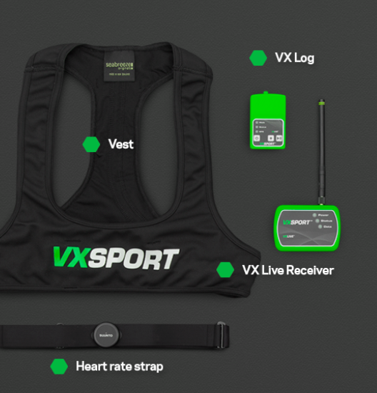
Objective Data: Microtechnology
Sport microtechnology companies measure variables through global positioning systems (GPS), accelerometry, & heart rate
They have created an “all-in-one” variable (A1M) to provide a composite score for external load
VX Sport – Athlete Load (AL)
Notes:
Objective Data

Slide 8
Athlete Training Load: The Big 5 Metrics
Total distance
For a session, drill, game, etc.
Meters or yards
High-intensity distance (HID)
Distance run that exceeds a given speed threshold (>60% max speed)
Meters or yards
Sprints
# of sprint efforts above a given speed threshold
Count
Accelerations
# of fast starts above a given threshold
Count
Decelerations
# of quick stops above a given threshold
Count

Slide 9
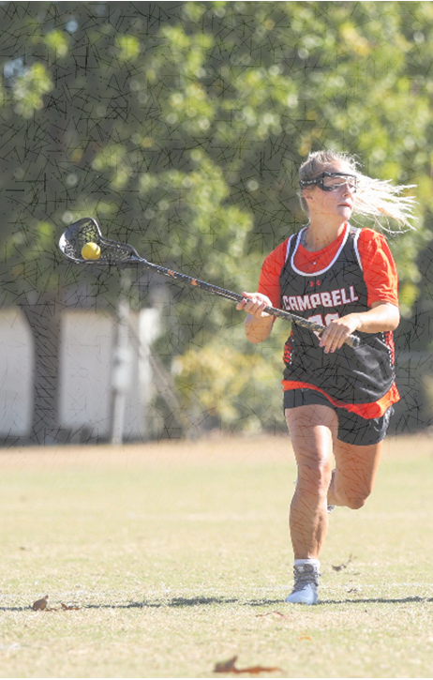
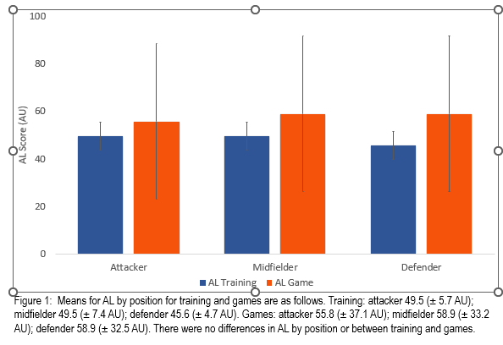
Evaluation of Athlete Load & Relationship Between Equation Variables in Division I Women’s Lacrosse
Thornton & Bunn (2023)
Notes:
These data serve as references for AL scores during training and games for women’s collegiate lacrosse. It is intended for these data to be utilized as benchmarks for coaches to use to provide greater insight on how athletes respond to training volumes experienced.
No difference was found between AL training and games by position, which is a likely result of training intensity meeting the demands of games.

Slide 10
*
*
*
†
†
*
*
*
* indicates a difference (p < 0.05) between training and games. † indicates differences from attackers (p < .05).
*
*
*
†
*
*
*
Zone 1 <60% MSS
Zone 2 60-69% MSS
Zone 3 70-79% MSS
Zone 4 80-89% MSS
Zone 5 ≥90% MSS.
Notes:
MSS – maximum Sprint Speed
Sprint zones are measured by the number of sprints conducted and distance moved in zones 1 through 5. Each zone is determined by a percentage of an athlete’s maximum sprint speed (MSS), with sprint
zone 1 <60% MSS, sprint zone 2 60-69% MSS, sprint zone 3 70-79% MSS, sprint zone 4 80-89% MSS, and sprint zone 5 ≥90% MSS

Slide 11
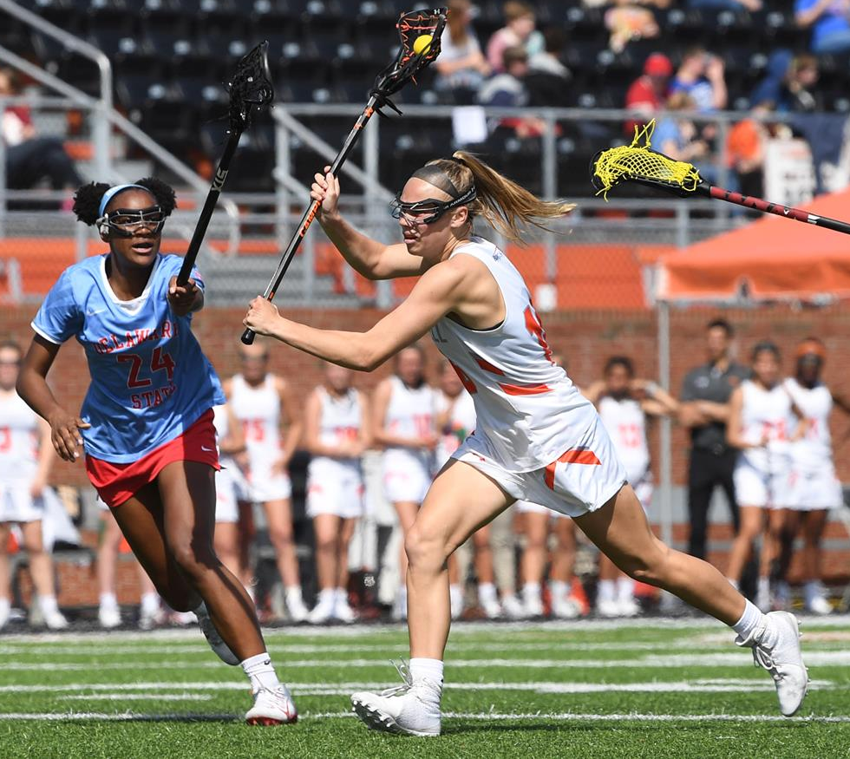
Notes:
High-speed running density (HSRd) is the ratio of high-speed efforts
and distance covered. This study aimed to evaluate differences in
HSRd between training, games, and among positions in collegiate
women’s lacrosse, and correlate HSRd with other training metrics.
Data were collected during a collegiate training year (practices
n = 162, games n = 14) through players (n = 25) wearing micro-
technology. HSRd differed between training sessions and games
(p < .001, d = .281) and by position (p < .001, d = .005-.712). Games
(14.7 ± 13.8%) had a higher HSRd than training sessions
(13.1 ± 13.7%), and goalies had higher HSRd during games than
the other positions. HSRd was moderately inversely correlated
(p < .001) with max speed (r = −.395–.543) and had low inverse
correlations (p < .001) with distance (r = −.134–.225), accelerations
(r = −217–.233), and decelerations (r = −.195–.268). Training did not
mimic the HSRd of games. Defenders and goalies perform intense
reactionary movements to make a defensive play, resulting in
higher HSRd.
ARTICLE HISTORY
Received 22 July 2020
Accepted 6 April 2021
KEYWORDS
Workload; sprint; training
volume
Introduction
Several metrics for athlete load management and evaluation are provided through global
positioning systems (GPS) including distance, speed, number of accelerations, number of
decelerations, and distance run at a high-intensity. These data have been used in a variety
of ways to further improve training efficiency, athlete workload management, and man-
age injury risk (Gabbett & Ullah, 2012; Hulin et al., 2016; Malone et al., 2017). GPS
monitoring also allows for more advanced metrics, such as speed zones or accelerations
and decelerations in a workout, and these metrics could prove valuable in bettering
athletic performance and recovery. A relatively new metric of high-speed running density
(HSRd), or sprint density was recently introduced by Tierney et al. (2018). HSRd is defined
as a ratio between the number of high-speed running efforts and high-speed running
volume (distance covered). The metric was created because there was no prescribed
method of measuring the relationship between high-intensity bouts of running and the
distance covered at high speed, but there is plenty of evidence on the positive impact of
high-intensity interval training on physiological components that subsequently improve
sport performance (Blomqvist & Saltin, 1983; Maillard et al., 2018). HSRd may also be
critical for understanding injury prevention and recovery timetables

Slide 12
 | IC | OC | Effect Size
PT (min) | 49.94 (12.2)* | 67.42 (7.8) | 0.653
Total Distance (m/min PT) | 145.54 (26.7)* | 100.78 (8.0) | 0.713
Distance Rate (m/min/min PT) | 1.15 (0.2)* | 0.85 (0.1) | 0.701
HI Distance (m/min PT) | 10.85 (2.9)* | 7.82 (2.8) | 0.803
HI Sprints (num/min PT) | 0.12 (0.5)* | 0.09 (0.6) | 0.495
MED (m/min PT) | 215.69 (32.6)* | 155.38 (13.5) | 0.731
Accelerations (num/min PT) | 4.41 (0.5)* | 3.57 (0.3) | 0.829
Decelerations (num/min PT) | 1.01 (0.2)* | 0.74 (0.1) | 0.833
TRIMP (AU/min PT) | 11.60 (5.2)* | 6.96 (1.4) | 0.445
Notes:
Jen

Slide 13
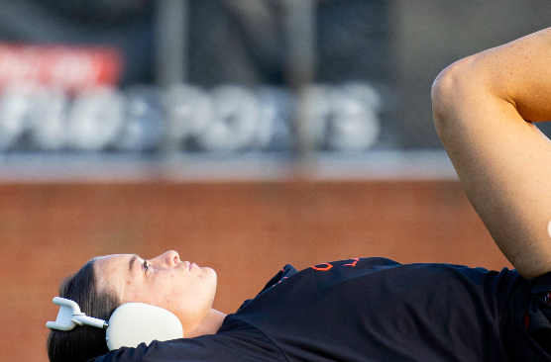
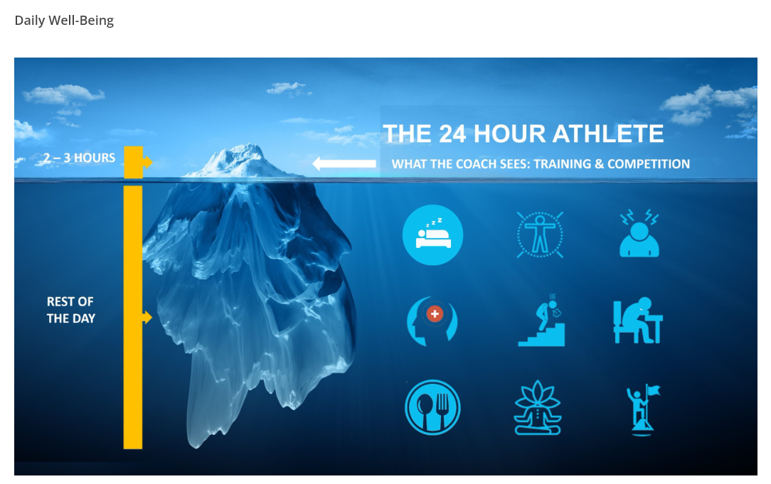
Subjective Data:
Daily Wellness Survey

Slide 14
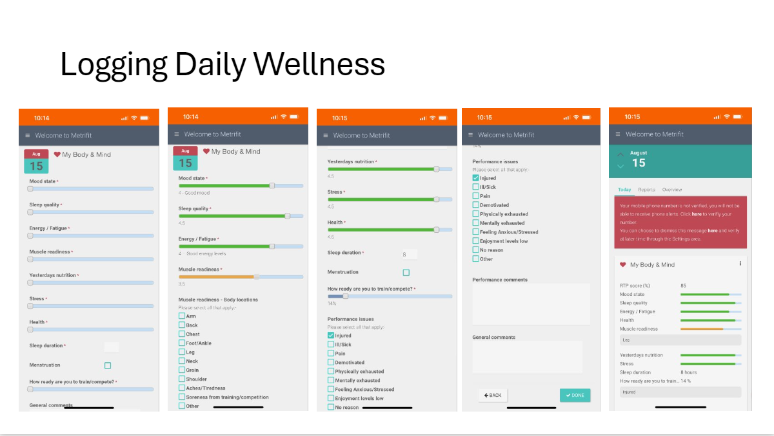



Slide 15
What about Wellness?
Crouch et al. (2021) |  | External Training Load Parameter Estimate (associated 95% CI); P-value
Effect | Subjective Wellness Score Comparison** | Distance | HID | Distance Rate | Athlete Load
Muscle Soreness | 100 v. ≤50 | -40.8 (-236.0, 154.4) 0.6820 | -35.3 (-74.9, 4.3) 0.0806 | -0.3 (-3.1, 2.5) 0.8494 | 0.7 (-2.8, 4.3) 0.6836
 | 75 v. ≤50 | 120.7 (-55.4, 296.8) 0.1790 | -22.0 (-57.7, 13.7) 0.2262 | 0.0 (-2.5, 2.5) 0.9964 | 1.1 (-2.1, 4.3) 0.5094
Sleep Quality | 100 v. ≤50 | 303.8 (50.0, 557.6) 0.0190 | 64.2 (12.7, 115.7) 0.0147 | 3.4 (-0.3, 7.0) 0.0681 | 5.7 (1.1, 10.3) 0.0158
 | 75 v. ≤50 | 310.5 (36.7, 584.3) 0.0263 | 72.7 (17.2, 128.3) 0.0103 | 2.1 (-1.8, 6.0) 0.2961 | 6.8 (1.8, 11.8) 0.0077
Fatigue | 100 v. ≤50 | 323.6 (52.2, 594.9) 0.0195 | 49.7 (-5.4, 104.8) 0.0773 | 2.3 (-1.6, 6.1) 0.2532 | 5.6 (0.6, 10.5) 0.0271
 | 75 v. ≤50 | 141.5 (-137.3, 420.3) 0.3195 | 13.8 (-42.9, 70.4) 0.6339 | 0.0 (-4.0, 4.0) 0.9969 | 2.7 (-2.4, 7.7) 0.3014
Stress | 100 v. ≤50 | 49.6 (-161.8, 261.0) 0.6452 | 14.0 (-28.8, 56.9) 0.5206 | -3.9 (-6.9, -0.9) 0.0116 | 1.5 (-2.3, 5.4) 0.4416
 | 75 v. ≤50 | -22.6 (-225.6, 180.4) 0.8269 | 21.4 (-19.8, 62.6) 0.3081 | -1.3 (-4.2, 1.5) 0.3616 | 2.3 (-1.3, 6.0) 0.2131
Overall Wellness† | - | 3.5 (1.2, 15.1) 0.0213 | 0.8 (-0.6, 2.2) 0.2737 | 0.001 (-0.1, 0.1) 0.9793 | 0.2 (0.0, 0.3) 0.0132
Notes:
Paula
For each one-unit increase in overall wellness score, total distance (3.5 m, 95%CI 1.2–15.1) and Athlete Load (0.2AU, 95%CI 0.0–0.3) increased. Pre-training wellness scores and sub-scores are predictive of external load training output. Monitoring athlete wellness systematically can help coaches with decision-making relevant to training and game performance.

Slide 16
Chronotype & Sleep (Grace et al., 2023)
Lower scores = Better sleep
†‡
*
*
* indicates a difference from September (p < .05), † indicates a difference from October (p < .05), and ‡ indicates a difference from November (p < .05).
Notes:
MEQ
PSQI
Chronotype not as meaningful as we might have expected – haven’t looked at it related to performance yet as data so far was in off season vs on season (Fall 2021)
N vs. M/E – morning/evening
Morningness/Eveningness Questionnaire (MEQ) identifies three different chronotypes: “morning” type, “evening” type, and neither type. Morning types have peak performance in the early hours of the day whereas evening types have a significantly later peak time in the circadian peak. Neither types do not have a distinct time area at which their performance peaks.
Chronotype refers to one’s natural inclination to the times of day at which they are more energetic or when they prefer to sleep (Pacheco et al, 2021). It is a complex phenotype including many genetic and non-genetic determining factors and is based on circadian behavior.
Sleep was evaluated through a daily sleep quality wellness check as well as a monthly assessment for quality and quantity via the Pittsburgh Sleep Quality Index (PSQI). Chronotype was assessed via the Reduced Morningness-Eveningness Questionnaire. Chronotype and sleep quality were evaluated at the beginning and end of each semester.
Of the 32 athletes initially enrolled in the study, there were inconsistent survey data and training data (due to injury) for 18, thus data for 14 athletes were analyzed for this study.

Slide 17
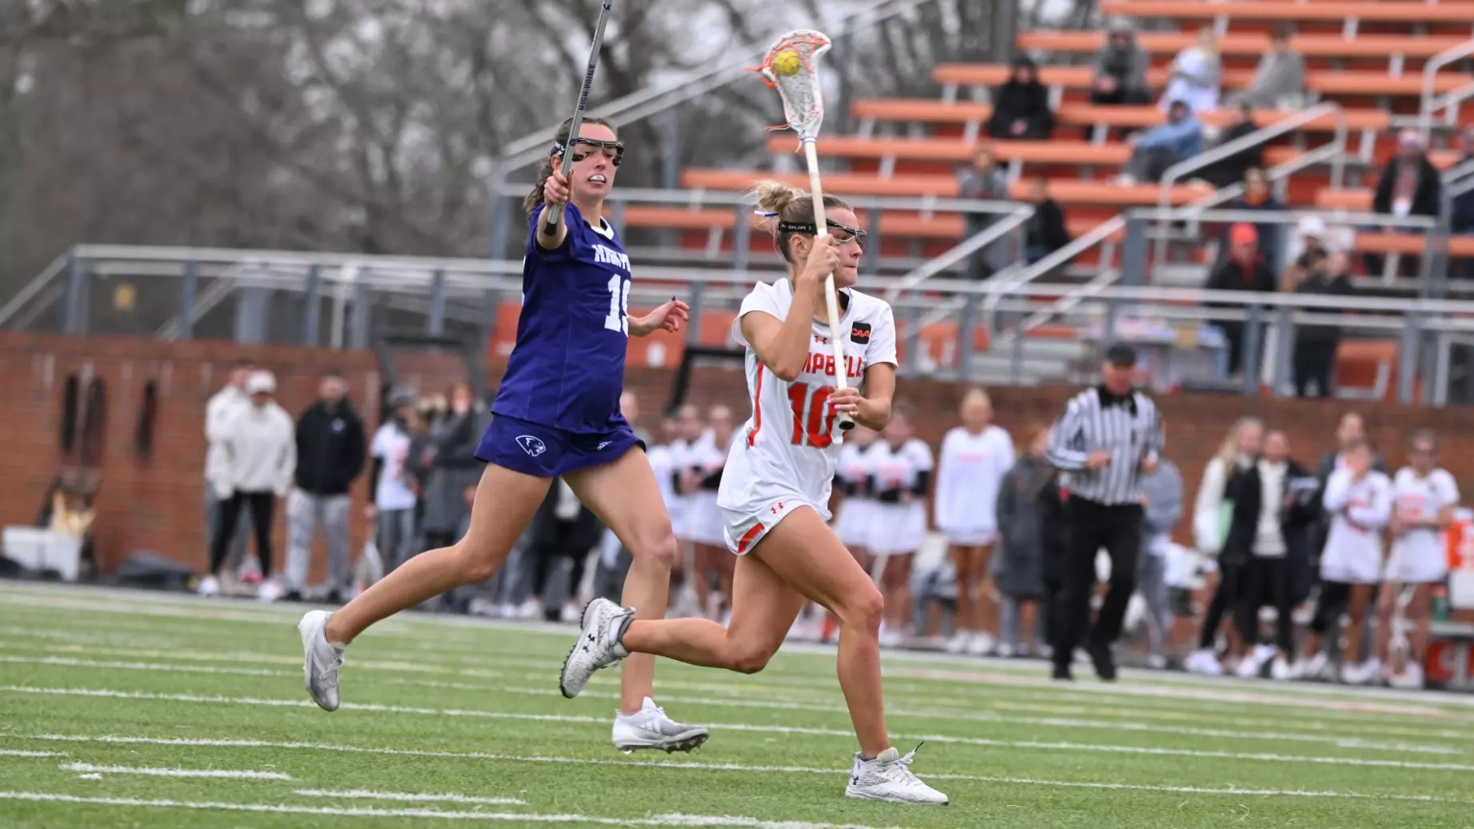
Psychological Hardiness (Cooley et al., 2023)
Kobasa (1979)
Bartone et al. (1989) Dispositional Resilience Scale-15
Commitment
Control
Challenge
Notes:
The DRS contains 45 statements about general life (e.g., “Most days, life is really interesting and exciting for me” and “Planning ahead can help avoid most future problems”) – 15 items for each subcomponent. Each participant was asked to indicate the truthfulness for each statement on a 4-point Likert scale anchored at 0 (not at all true) and 3 (completely true). Scores for each subcomponent range from 0 to 45. The composite hardiness scored ranges from 0 to 135. Cronbach's alpha coefficients of .74 for hardiness composite, .78 for commitment, .69 for control, and .68 for challenge were found in this study.
Since lacrosse is a physically and mentally demanding sport, it is imperative to study the impact of hardiness on athletes. Suzanne C. Kobasa first introduced this concept in 1979. She stated psychological hardiness has three components: commitment, control, and challenge. Those high in commitment exhibit determination and are dedicated to conquering the task at hand. People who harness control, are more likely to problem-solve and take charge of the situation. Those who have the challenge component, view difficulties as a challenge, rather than crutch. With all of these combined, overall hardiness can be analyzed, like it was in this study.
This study aimed to analyze psychological hardiness in 27 Division I women’s lacrosse players at Campbell University. This topic was researched in order to see if classification and position played a role in psychological hardiness, which is composed of control, challenge, and commitment. It was shown that midfielders and attackers show the largest significant difference, no matter the age. This information assists coaches to evaluate tolerance to training load, formulate more effective practices, maximize performance, and demonstrates how different positions respond to stressors. Based on this analysis, midfielders are more adaptable, resilient, and have better stress-coping mechanisms, than attackers or defenders. For any further questions or comments, please contact me at my email. Thank you for your time and interest in this field of research.

Slide 18
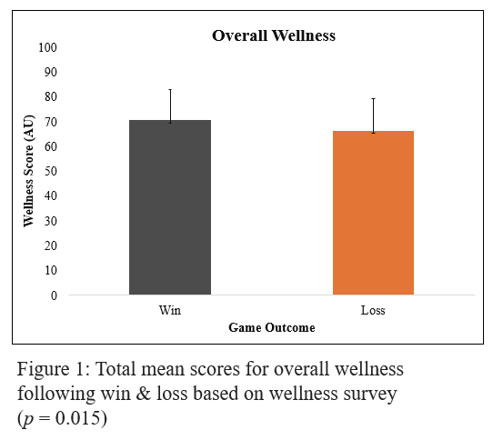
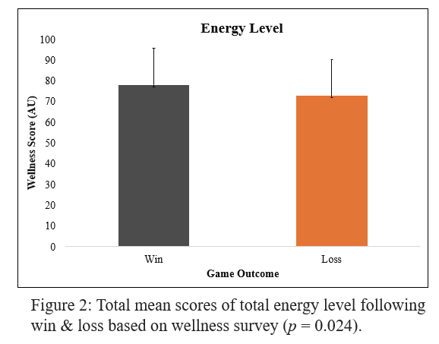
Wellness Following Wins & Losses Based on Psychological Hardiness in Division I Women’s Lacrosse (Cooley et al., 2023)

Slide 19
Psych hardiness
Weekly changes in sRPE for both groups.
* indicates a difference from weeks 3-8 (p < .05)
† indicates a difference from week 2 (p < .05)
*
*
†
*
†
†
†
†
†
Changes over time in mean wellness for both groups. * indicates a difference from week 1 (p < .05)
† a difference from week 2 (p < .05)
Notes:
No differences in daily wellness or sRPE by level of hardiness (p = .511)
Wellness scores declined throughout semester (p < .005),
sRPE scores were lower during the 8-hour training weeks compared to the 20-hour training weeks (p < .001)
Paula
Below and above average hardiness based on previous research
The highest wellness scores occur in weeks with low hour practice and more academic breaks. Higher RPE scores come from weeks with over four practice hours and weeks with high-intensity pre-season tournaments. While there is no direct correlation between wellness, RPE, and hardiness, the data suggests the lower the RPE, the higher the wellness, and vice versa. This research can assist coaches to implement wellness tactics to decrease RPE and increase performance.

Slide 20
Comparisons of sRPE between coaches & players
Coaches overestimated sRPE for training (876 ± 349 AU) compared to:
Players as a whole (829 ± 214 AU)
Attackers (842 ± 229 AU)
Midfielders (857 ± 240 AU)
Defenders (849 ± 233 AU)
The correlations ranged r = .834-.888.
Notes:
Paula
Session RPE – RPE x duration of training

Slide 21
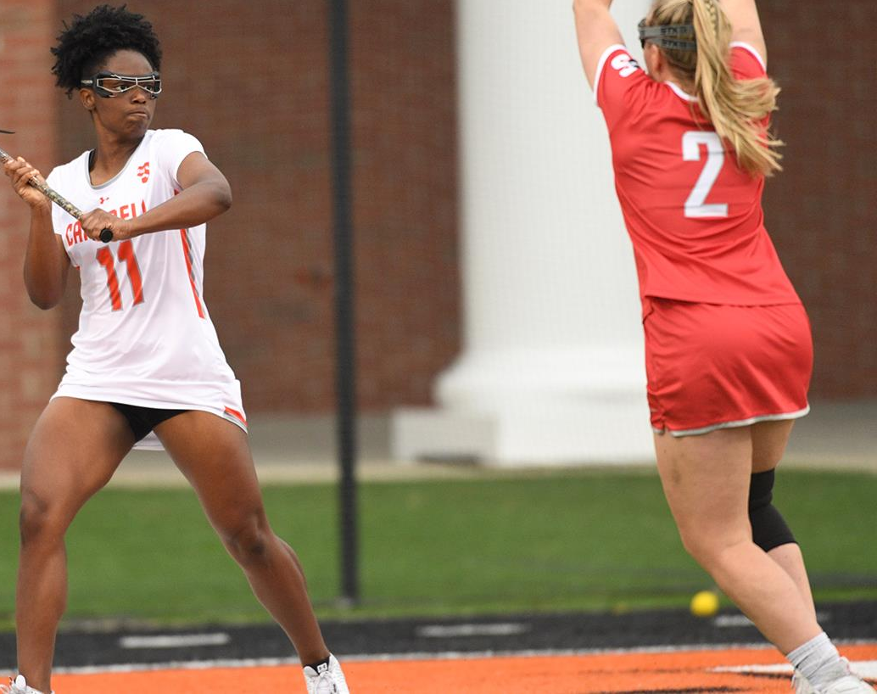
Help Coaches Plan Effective Practices & Manage Training Loads
Assess psychosocial variables (e.g., psychological hardiness, burnout, wellness) & teach athletic coping skills
Help athletes increase self-awareness
Consider academic load when planning training sessions for all seasons
Teach athletes both physical & mental recovery are essential to continued performance improvements
Incorporate goal setting sessions focused on both mental & physical health throughout the training season
Notes:
, as daily wellness may decrease throughout the semester
Use Sport Psych

Slide 22
